Slide 1


RAJKIYA ENGINEERING COLLEGE, BIJNOR
AICTE APPROVED GOVERNMENT ENGINEERING COLLEGE AFFILIATED
TO DR. A.P.J. ABDUL KALAM TECHNICAL UNIVERSITY LUCKNOW (U.P)
A PRESENTATION ON
A MODIFIED SELF CHARGEABLE ADAPTER FOR CHARGING THE
ELECTRONIC DEVICE UNDER 5 V & 2 AMP
Presented by
Vishal Kumar (2107350200053)
Shivam (2107350200044)
Ravi Shivam (2107350200037)
Submitted To
Dr. Mohmmad Ahmad
Dr. Archana Sharma
Dr. Navneet Kumar
Assistant Professor
Department of Electrical Engineering
Assistant Professor
Department of Electrical Engineering
Assistant Professor
Department of Electrical Engineering

Slide 2
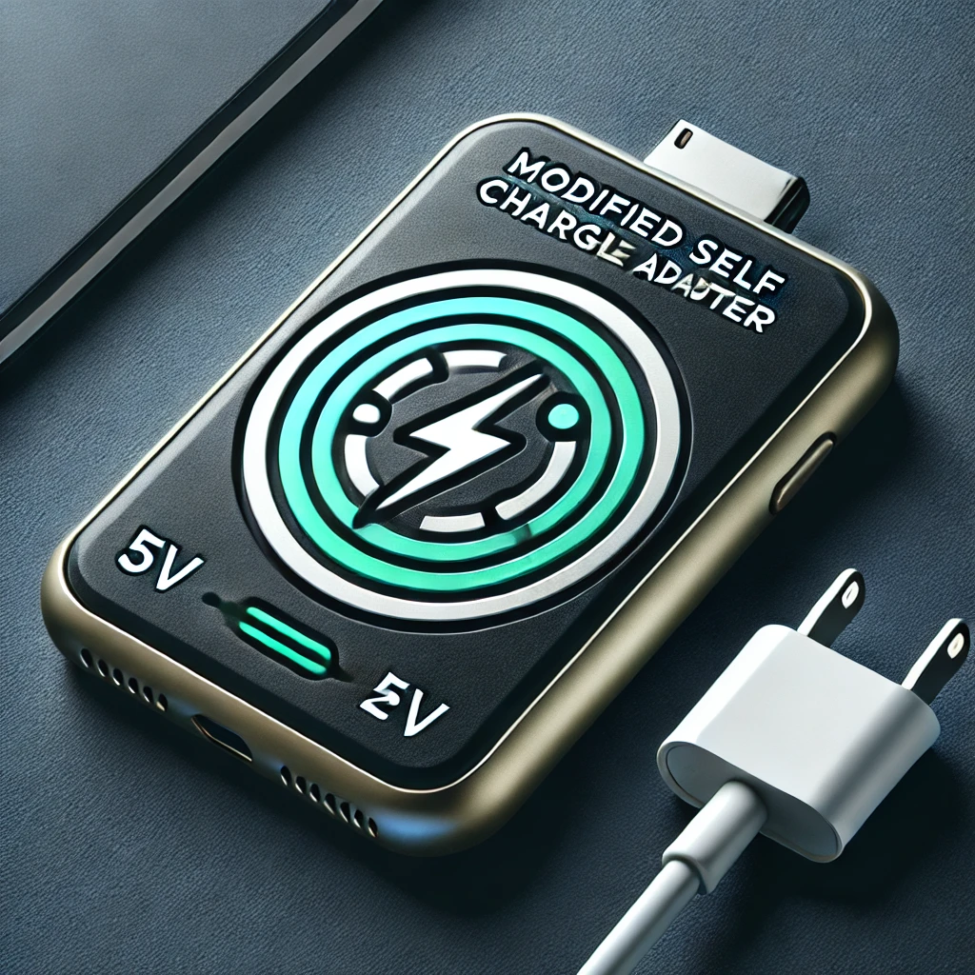
A Modified Self Chargeable adapter for charging the electronic devices under 5 V & 2 amp

Slide 3
CONTENT
Description of the problem
Solution
Basic idea
Theory
Components
Circuit diagram
Future plan

Slide 4
DISCRIPTION OF THE PROBLEM
We need to charge our electronic devices on regular basis again and again
For charging we use 3 things
Electric power
Adapter
Data cable
Adapter and data cable are portable whereas electric power is not.

Slide 5
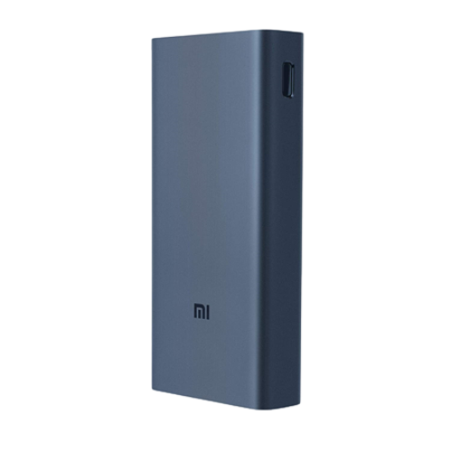
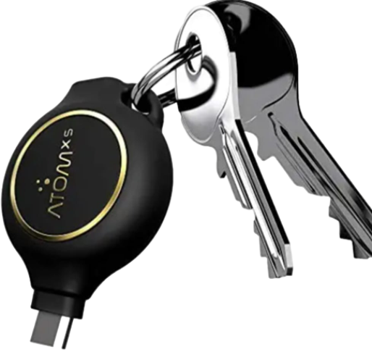
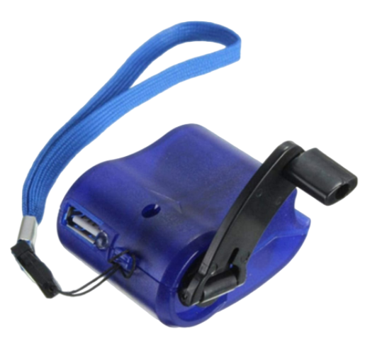
For providing electric power some options are available in market but these are not able to filling our needs as we want.
Power banks
Atom
others

Slide 6
SOLUTION
FLOW CHART
ELECTRIC POWER
According to the flow chart of charging system we replace normal adapter with our modified adapter.
It does not require external electric power.
SOCKET/PORT
ADAPTER
DATA CABLE
CHARGING OF MOBILE

Slide 7
According to energy conservation law :– Energy can neither be created nor be destroyed but it can be transfer from one form to another form.
MAGNETIC FIELD ENERGY
MECHANICAL ENERGY
ELECRICAL POWER

Slide 8
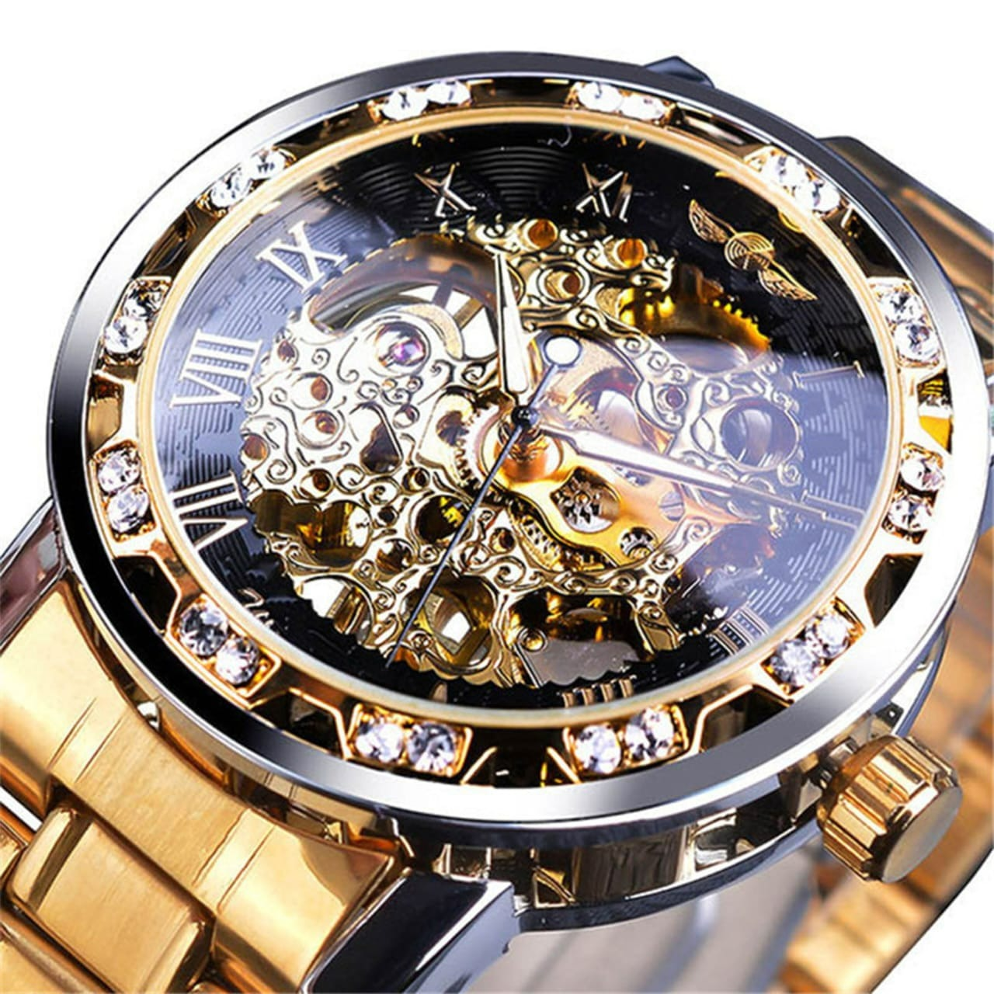
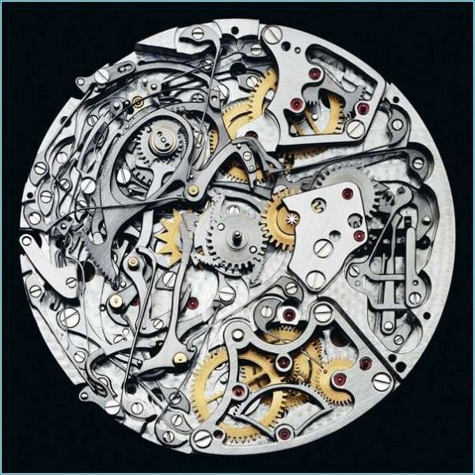
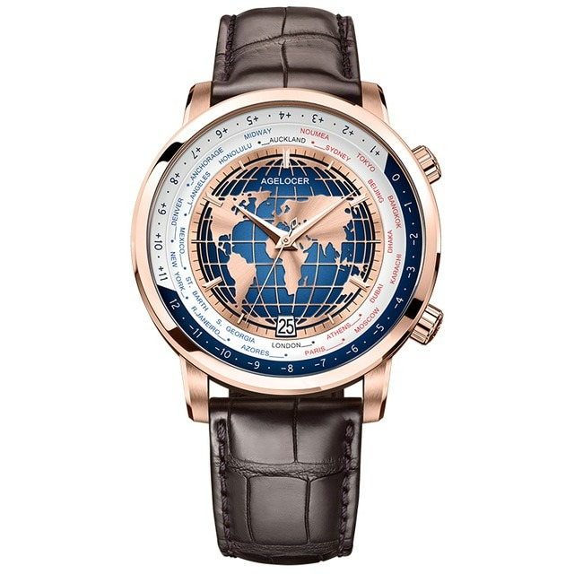
What is the basic idea ?
luxury watches ---: EX: ROLEX

Slide 9
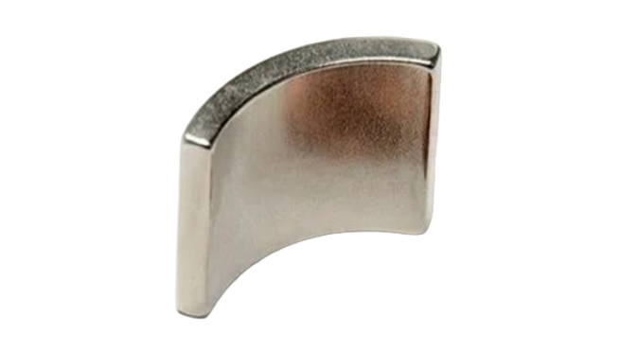
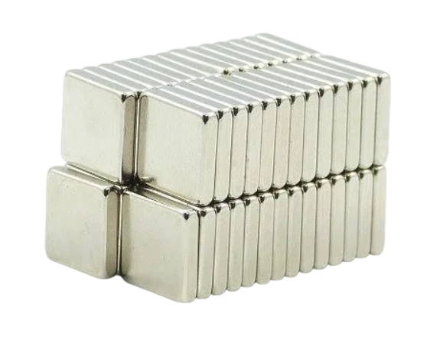
Components
MAGNETs
Size 14mm x 13mm x 2.4mm & 6mm x 5mm x 2mm
Neodymium magnets - UAMOU & N52
Rare earth ndfe B magnets

Slide 10
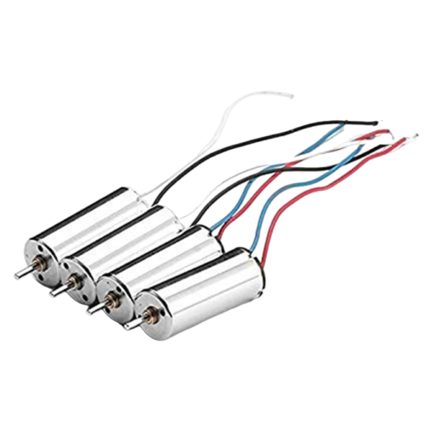
Dc motor/generator
Coreless motor 7x16mm with shaft size: 0.8 x 4.7mm.
Rated voltage is 3.7V - 4.2V. Current: 0.1A -1.5A.
Max speed: 48000 rpm(no load). Wire length 5cm/3".
Main color: silver

Slide 11
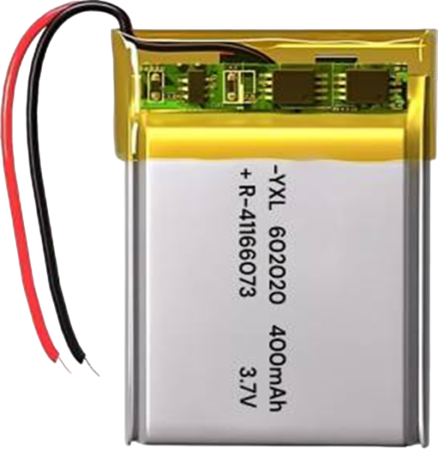
BATTERY
Type rechargeable battery
Input 5V
Output 3.7V
Capacity 400mAh

Slide 12
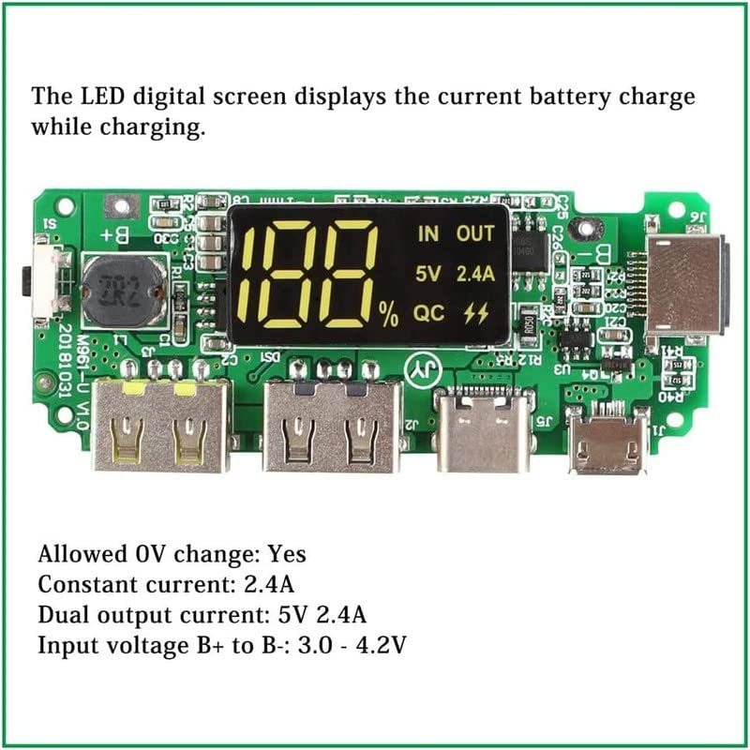
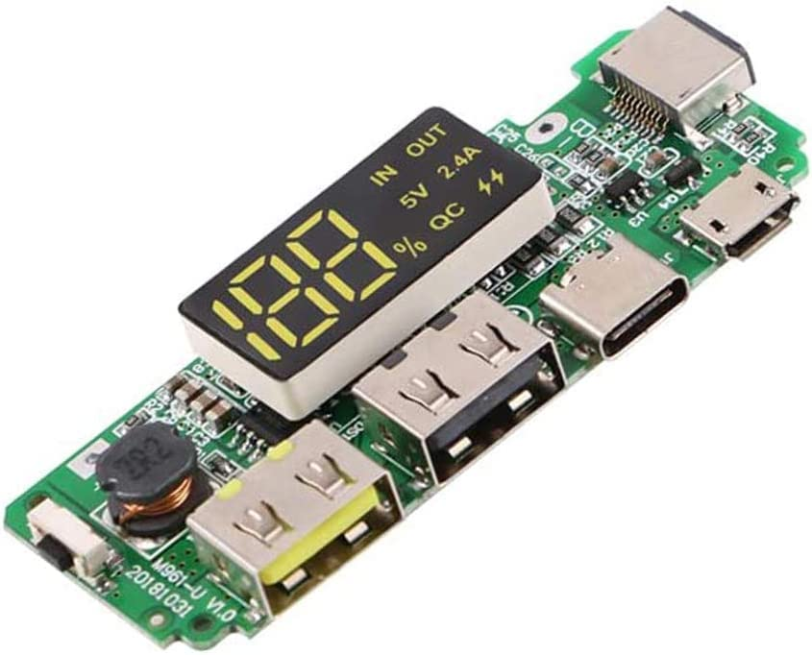
3.7 v to 5 v boost converter breakout board

Slide 13
boost converter
This module is a portable backup power supply with an input that matches the 5.0V adapter to charge the internal battery.
Use built-in battery for portable device to provide 5.0v/3.0a usb2.0 supply output for external devices.
Protection: overcharge protection, over discharge protection, short circuit protection, constant current.

Slide 14
Dc generator principle
A DC generator converts mechanical energy into electrical energy using the principle of electromagnetic induction:
1.Parts
A DC generator has a stationary field magnet and a rotating armature, which is a coil of wire.
Operation
The armature is placed between the poles of the field magnet. When the armature rotates, it cuts through the magnetic field, which induces an electromotive force (EMF) in the armature.

Slide 15
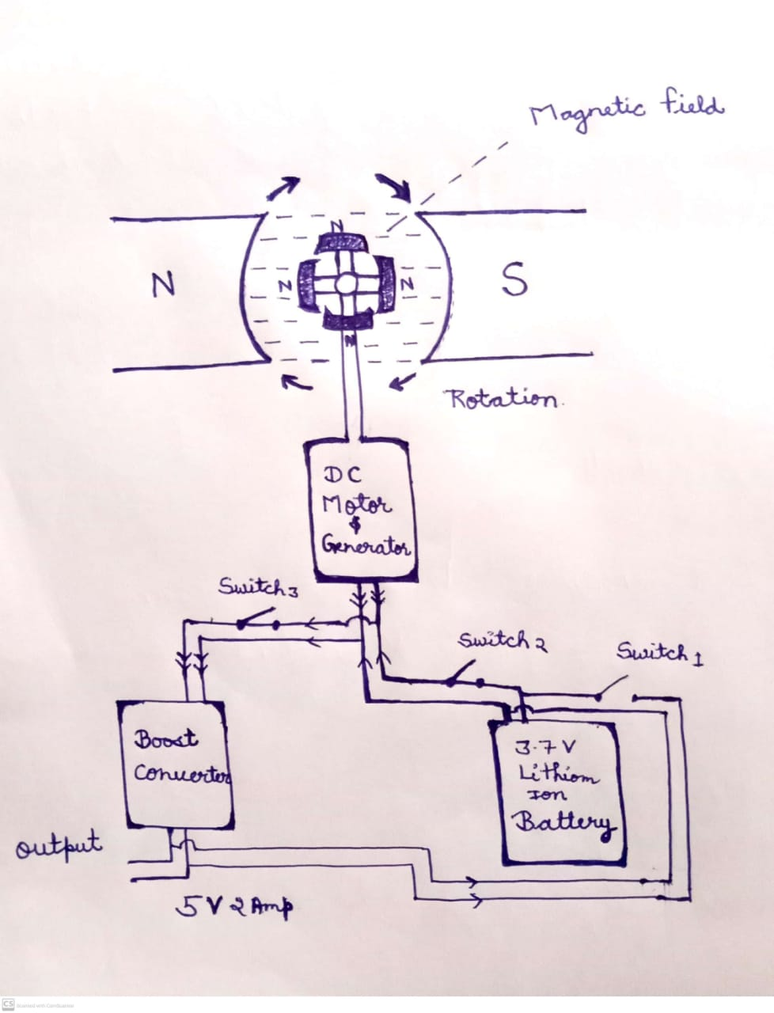
Circuit diagram and Working of device

Slide 16
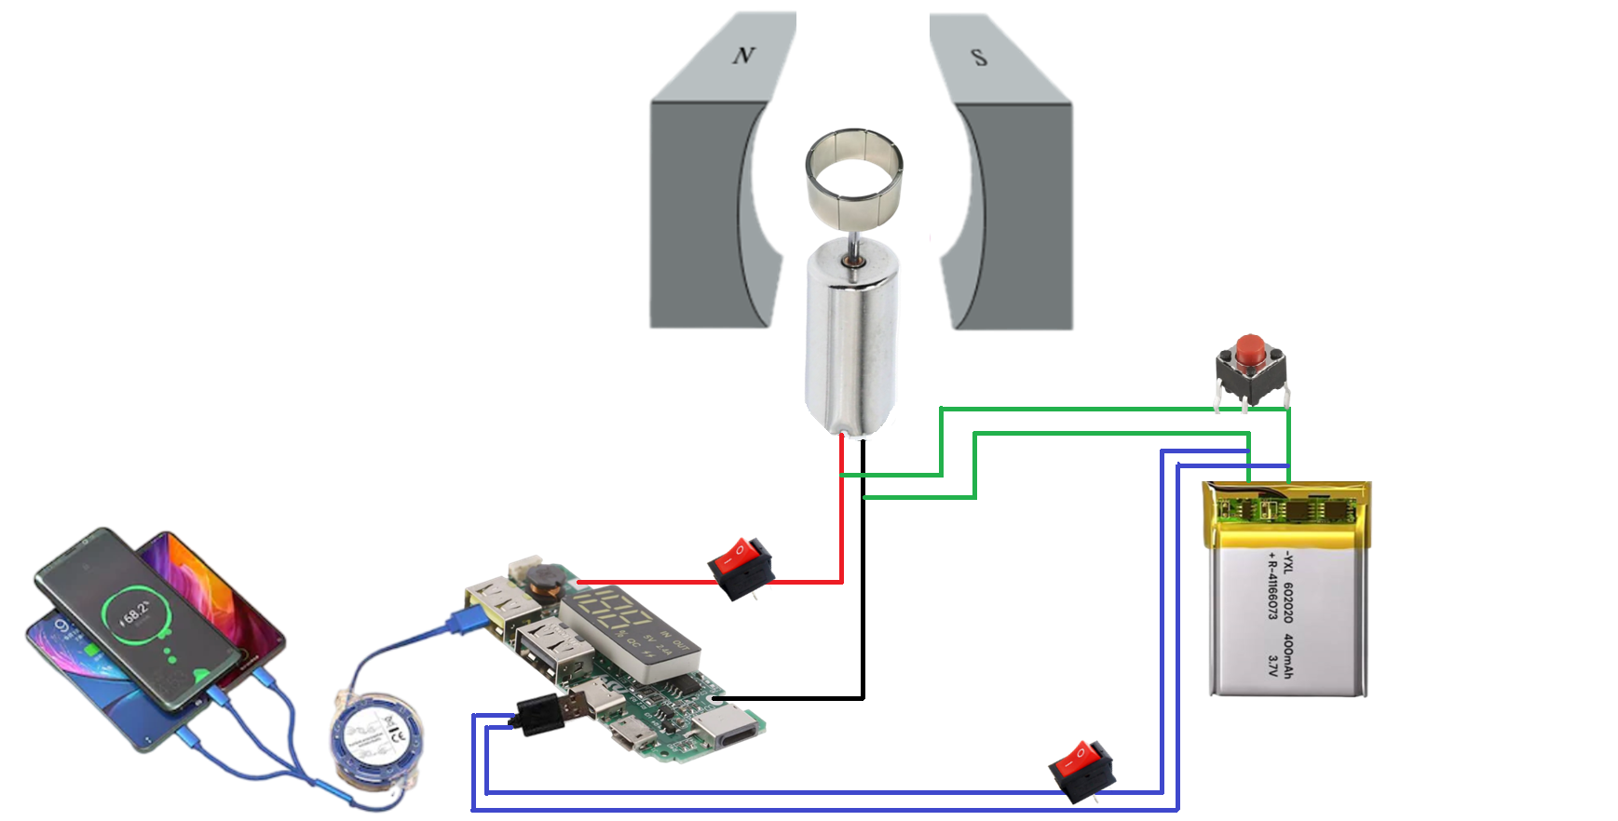
CIRCUIT DIAGRAM AND WORKING OF DEVICE
(Magnet)
{Mechanical disk for turn-off}
S1,Starter
(Dc motor)
3.7 V
(Converter)
5 V & 2A
(Battery)
S2,For charge starter battery

Slide 17
Working of device
When switch is closed of battery source then the motor start rotation.
Due to surrounding magnetic field arrangement on shaft of rotor.
Motor remains in rotation even after disconnecting through the source of battery.
Which results motor start working as generator on the principle of electromagnetic induction.
Switch of converter close then to get a constant current of 5v and 2 amp.
This output power can be use to charge the electronic devices.

Slide 18
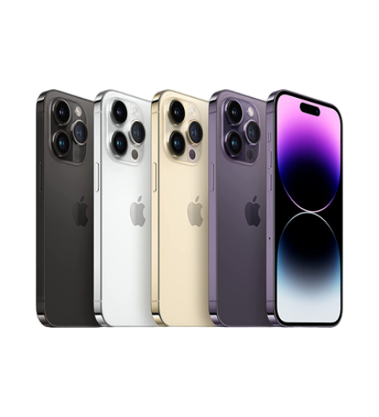
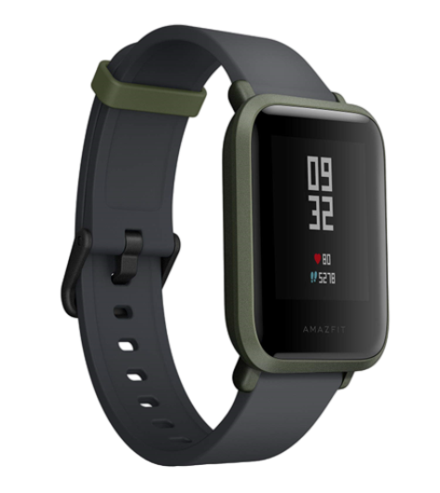
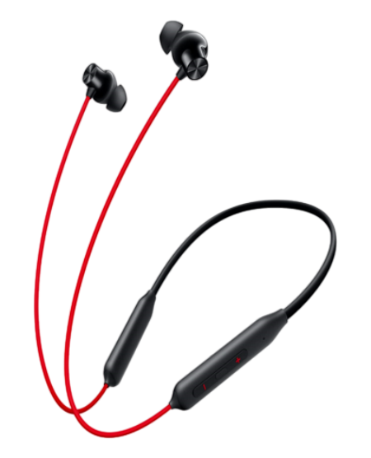
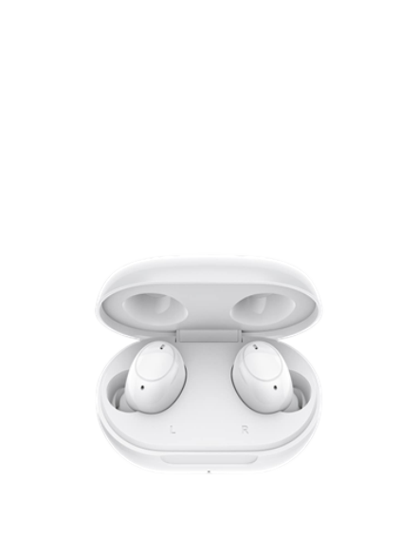
Electronics devices under{5 v & 2 amp}
Smart phones
Smart watches
smart earphones

Slide 19
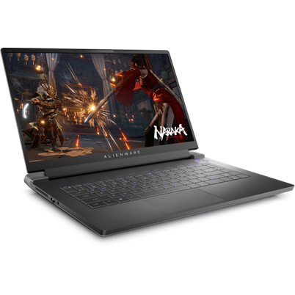

Future plan
By increasing its range, the device can support larger electronic devices like laptops.
Enhanced power capacity ensures efficient charging for high-energy devices.

Slide 20
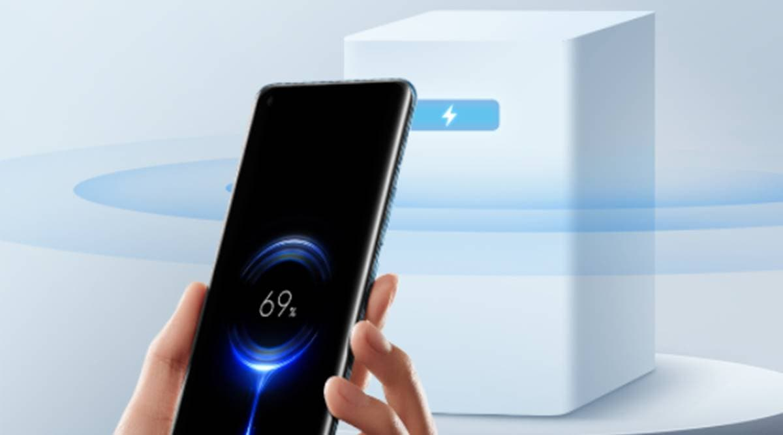
Future plan
Air Charging Technology
Enables over-the-air wireless charging using RF energy and infrared beams, removing the need for charging pads.
Supports 360-degree charging, allowing devices to charge seamlessly regardless of orientation or placement.

Slide 21
Thank you
For give us your valuable time

